Slide 1
Visiting Serbia on a Fulbright Specialist Grant: Education, Culture, Collaboration
Sergei Abramovich
Department of Curriculum and Instruction
Abstract: The presentation will share experience in visiting Universities of Niš and Novi Sad in Serbia in May-June 2012. Educational, cultural and collaborative aspects of this experience will be highlighted. Possible directions towards strengthening collaboration between SUNY Potsdam and University of Niš will be discussed.

Slide 2
Fulbright Specialist Program
Council for International Exchange of Scholars (CIES)

Slide 3
Where is Serbia?

Slide 4
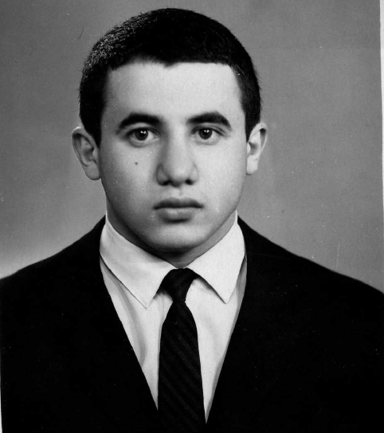
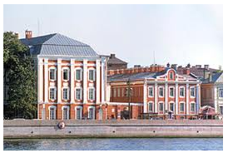
Why Serbia?

Slide 5
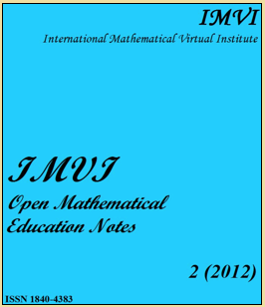
Why Niš?
Collaboration with Prof. Biljana Popović, University of Niš, on launching the journal “Open Mathematical Education Notes.”

Slide 6
Why Novi Sad?
Collaboration with Prof. Siniša Crvenković, University of Novi Sad (UNS), on launching the journal “Open Mathematical Education Notes”
Meeting with General Manager of International Mathematical Virtual Institute (IMVI) Prof. Daniel Romano (Bosnia & Herzegovina) in Sombor (home of the UNS school of education)
Doing a plenary talk in Sombor

Slide 7
Arrival to Belgrade: US Embassy’s Mercedes Benz

Slide 8
Hotel Niski Cvet in Niš

Slide 9
University of Niš Founded in 1965; consists of 13 schools, 1500 faculty, 630 staff and extracurricular staff, about 30,000 students.

Slide 11
Fulbright Program presentations
Fulbright Specialist Program Presentation I:
An experiential approach to elementary school mathematics
Експериментални приступ основних школа математике
Fulbright Specialist Program Presentation II:
Technology and hidden mathematics curriculum
Технологија и скривени курикулум математика
Fulbright Specialist Program Presentation III:
Discovering new mathematical knowledge in the context of (secondary teacher) education
Откривање новог математичког знања у контексту (наставник средње) образовање
Fulbright Specialist Program Presentation IV:
Collateral learning and mathematics teacher education
Колатерална учење и образовање наставника математике

Slide 12
Representing SUNY Potsdam

Slide 13
Lecture at University of Niš

Slide 14
A photo shoot

Slide 15
Interview: University of Niš

Slide 16
Visiting high school in Niš

Slide 17
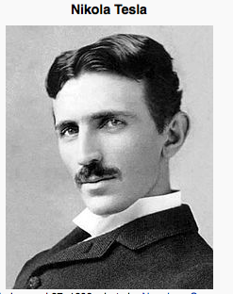
Nikola Tesla (1856-1943):
a Serbian-American inventor, physicist, mechanical engineer, electrical engineer, and futurist.

Slide 18
In the school’s computer lab

Slide 19
Students sharing their work with a visitor from SUNY Oswego

Slide 20
Sonja—a teacher of mathematics and an author of OMEN

Slide 21
While Principal is absent

Slide 22
Near Constantine the Great (283-337) Introduced Christianity to the Roman Empire Born in Niš

Slide 23
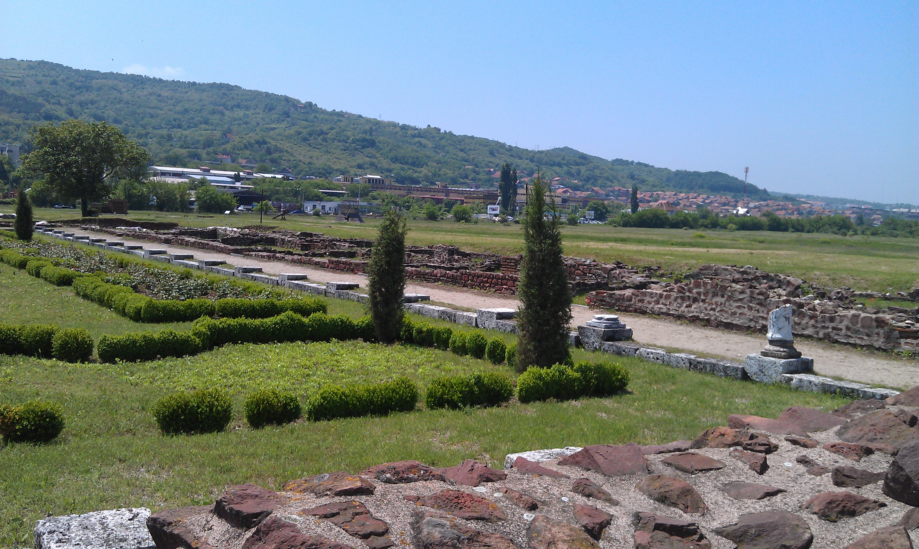
Niš: The ruins of antique Mediana—temporary residence of Roman kings

Slide 24
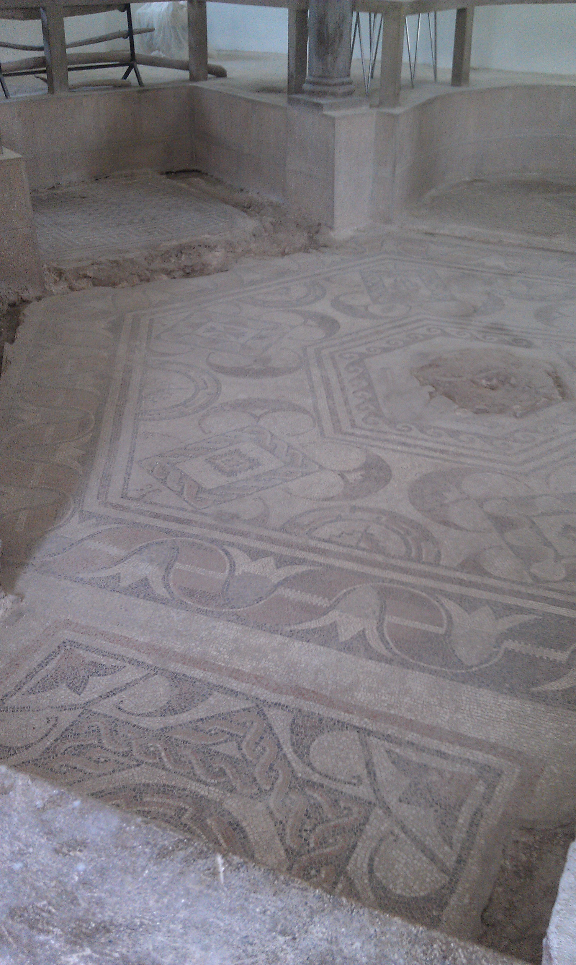
Mosaic in a room where Roman kings stayed while travelling

Slide 25
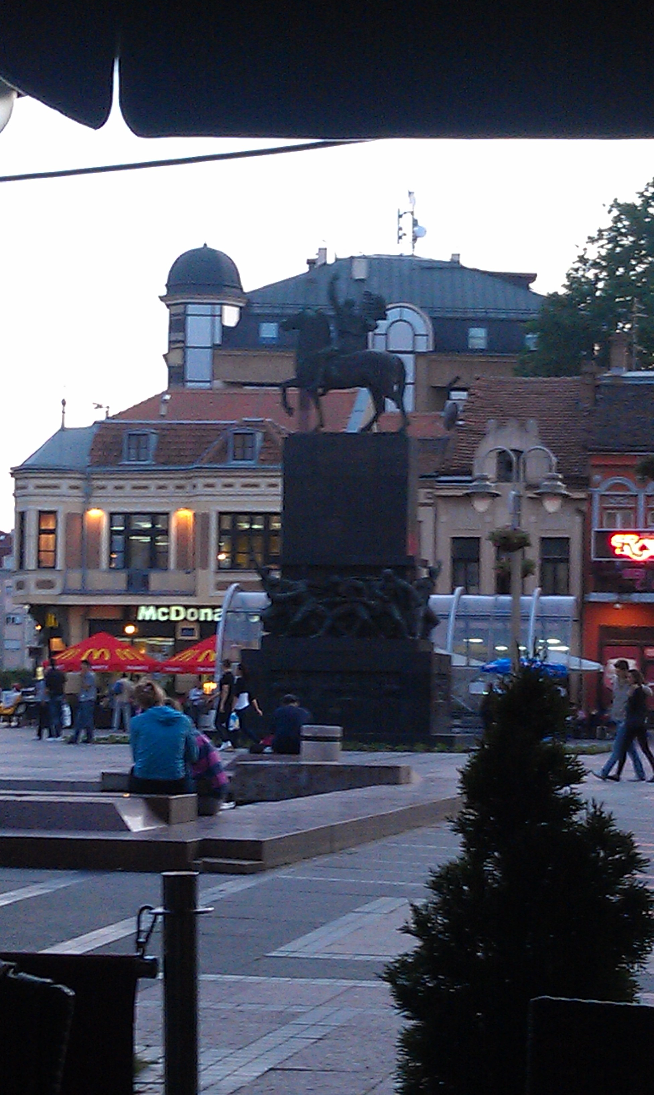

Slide 26
A fragment of Skull Tower built by Turks in the early 19th century using 952 skulls of Serbian soldiers in order to scare Serbs. Currently, only about 100 skulls remain.

Slide 27
Serbian wedding: Do you see a familiar face?

Slide 28
Sombor: The UNS School of Education
Founded in 1778

Slide 29
Teaching college, est. 1778

Slide 30
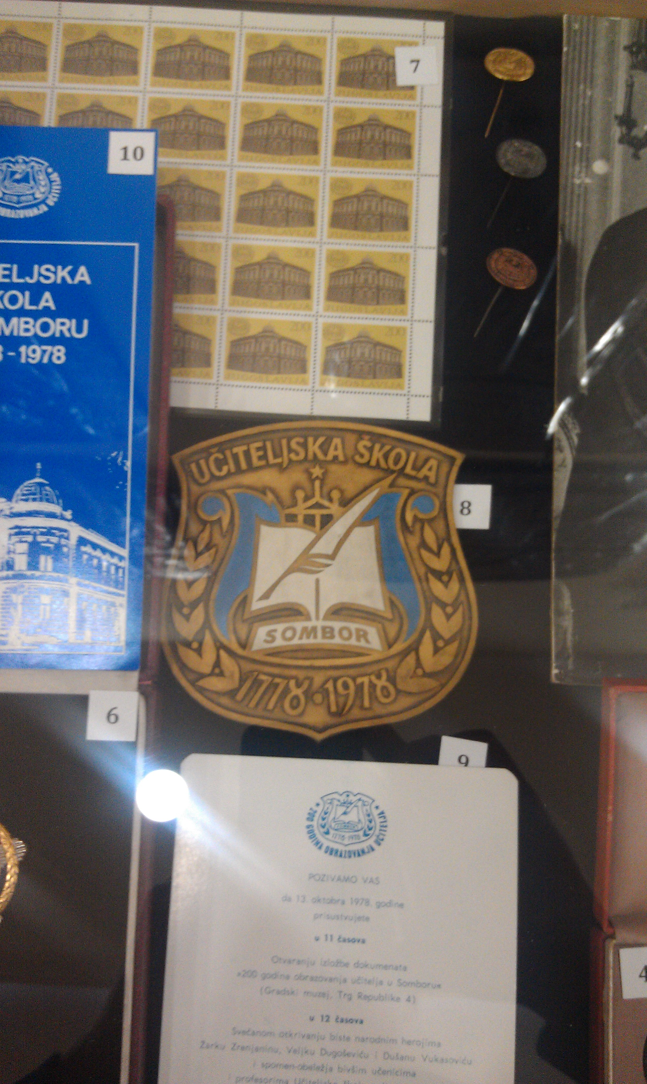
Bicentennial badge of the Sombor Teaching College

Slide 31
Sombor Museum of the School of Education

Slide 32
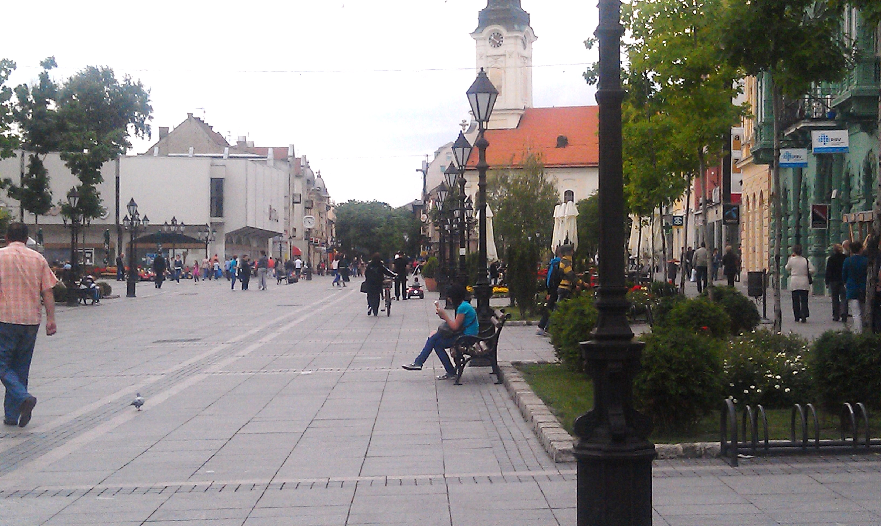
In downtown Sombor

Slide 33
Conference Program

Slide 34
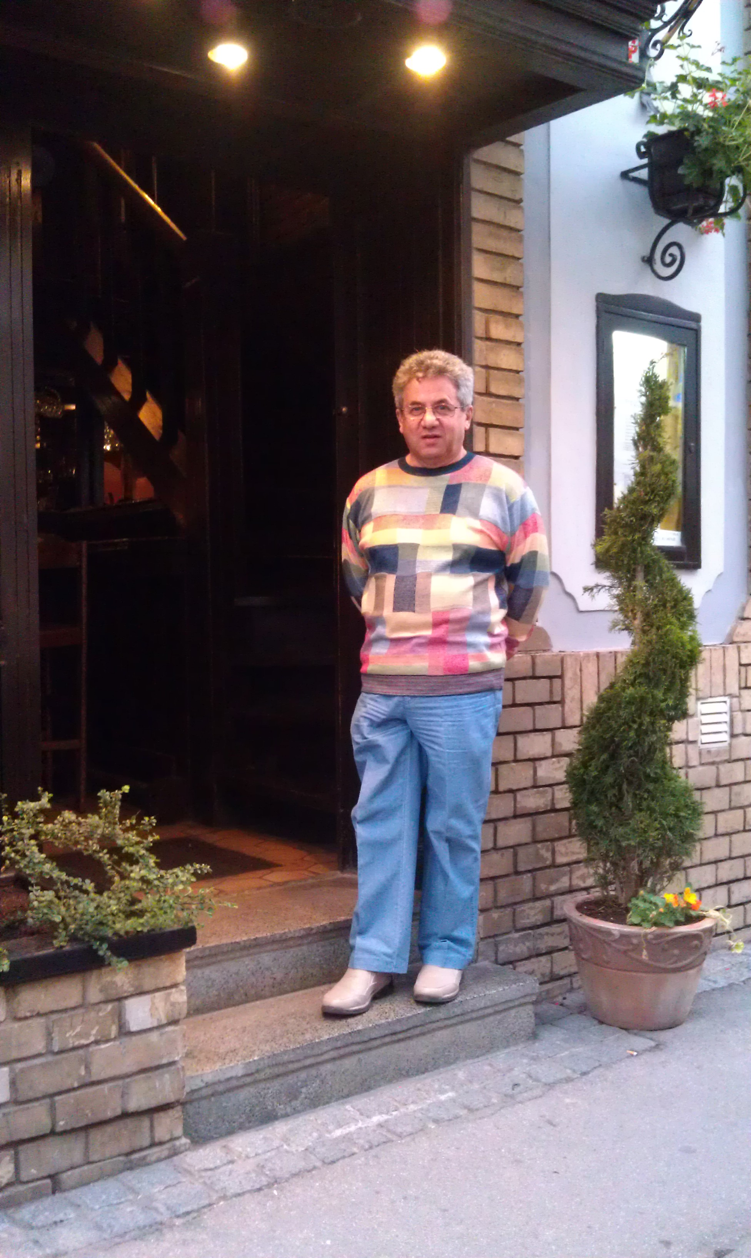
At the entrance to the hotel in Sombor

Slide 35
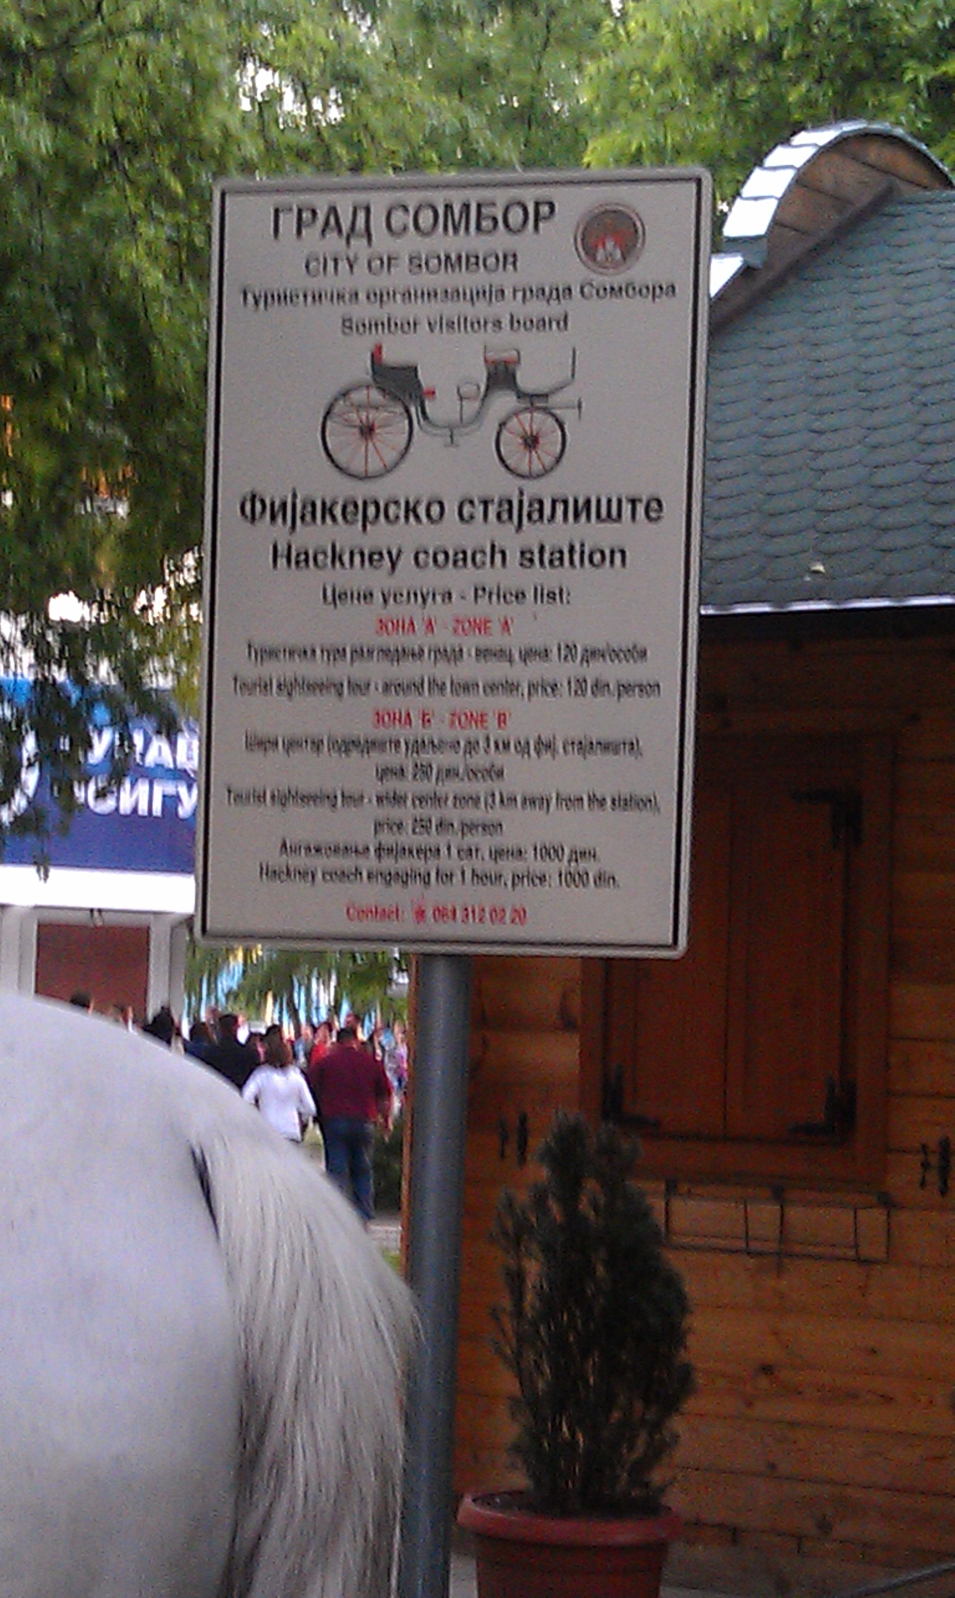
Café and horse back (Sombor)

Slide 36
Fulbright specialist after horse ride in Sombor

Slide 37
Arriving to Novi Sad Educational system dates back to the 11th century

Slide 38
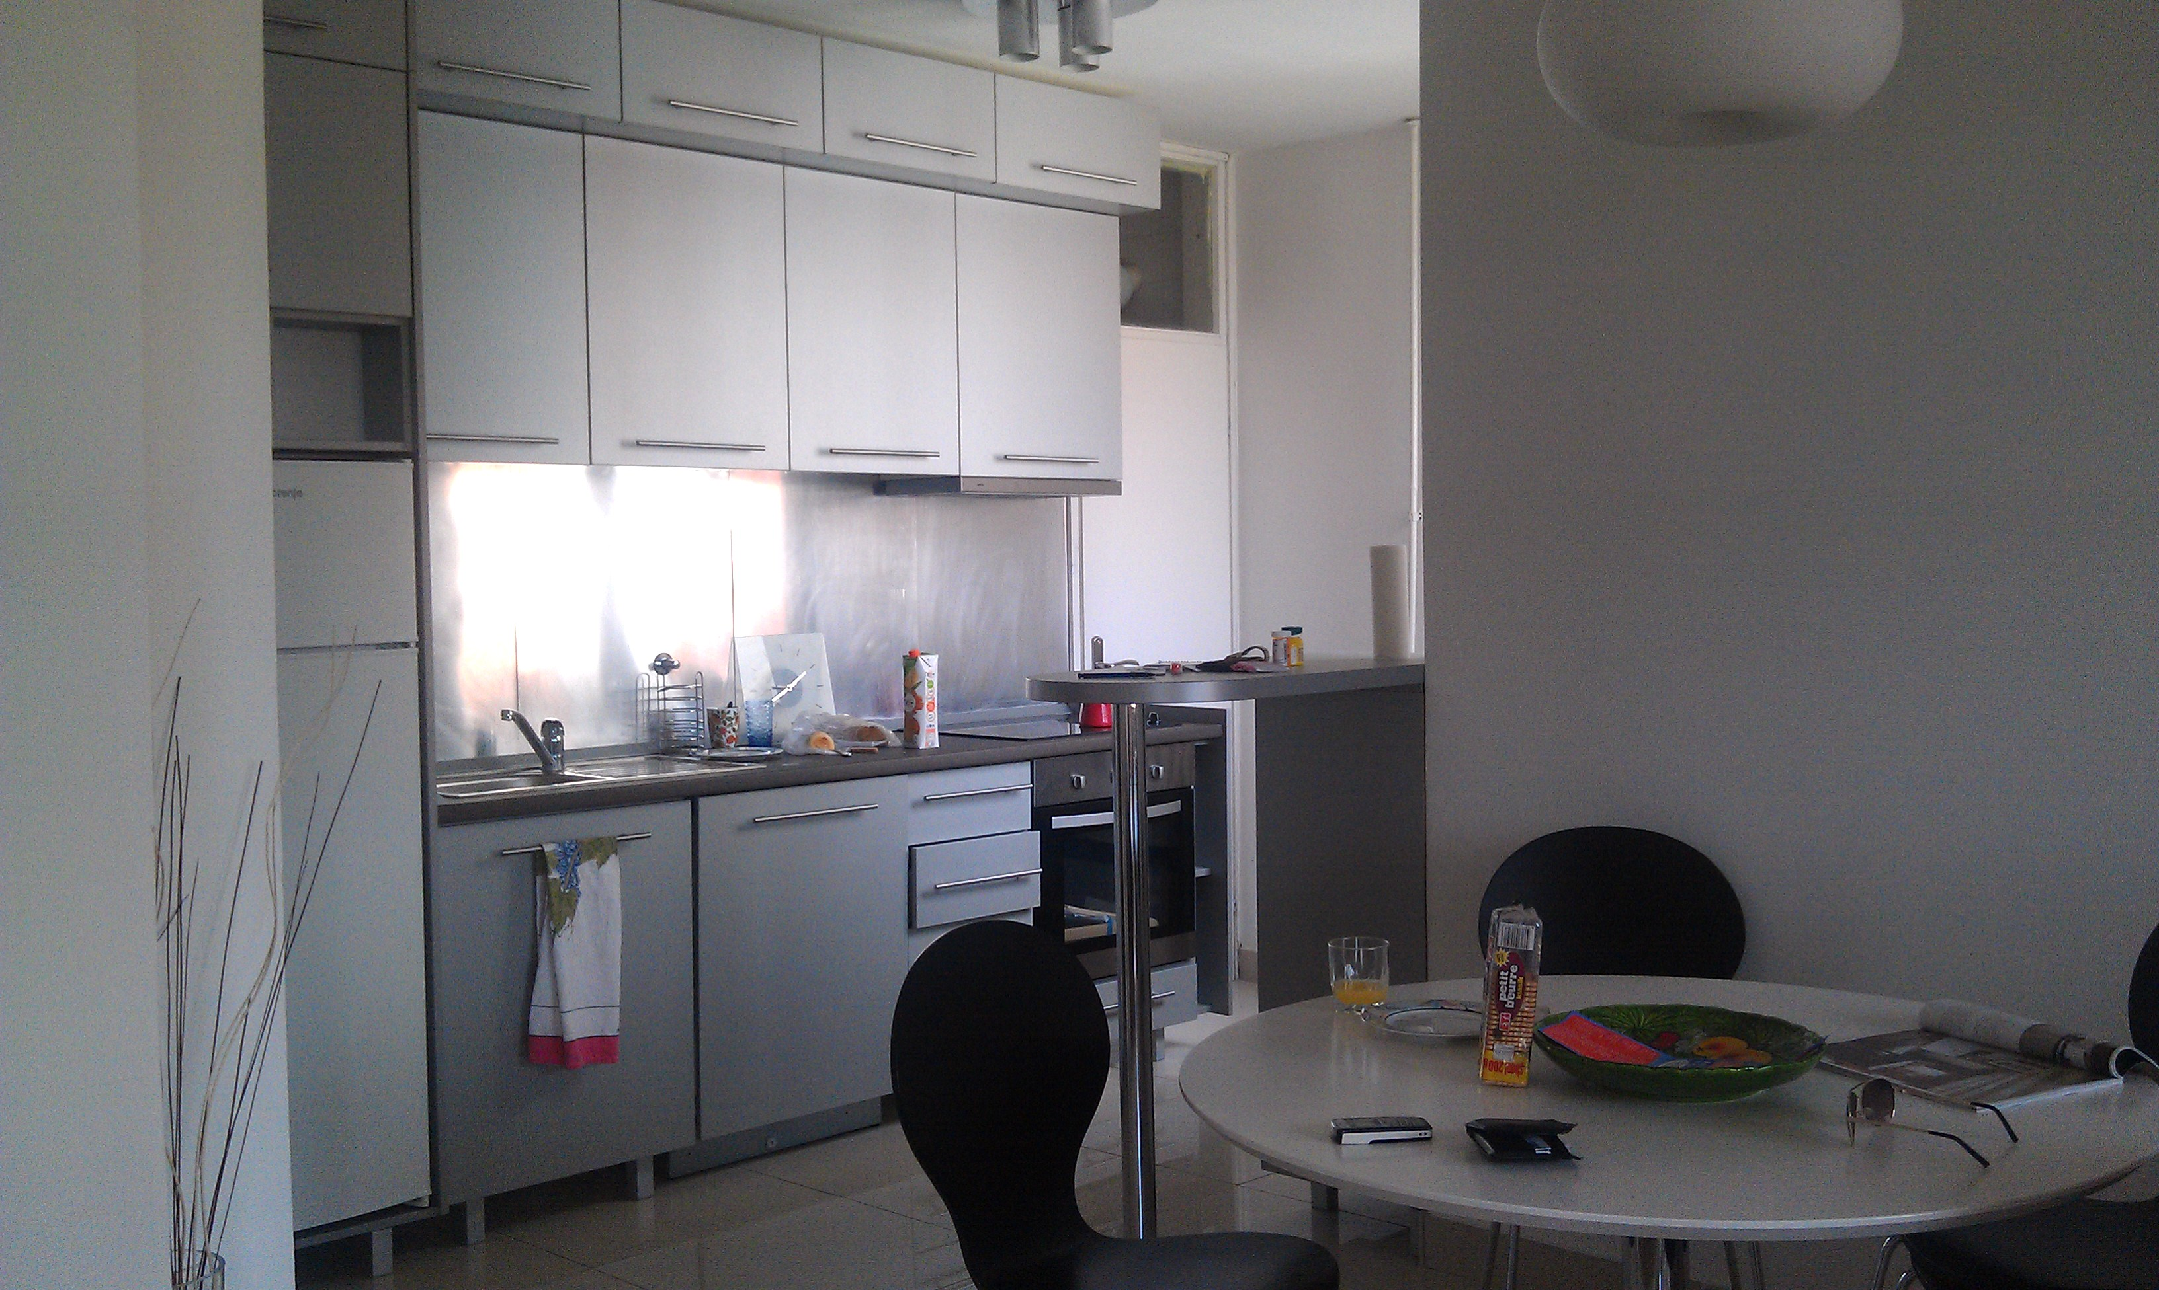
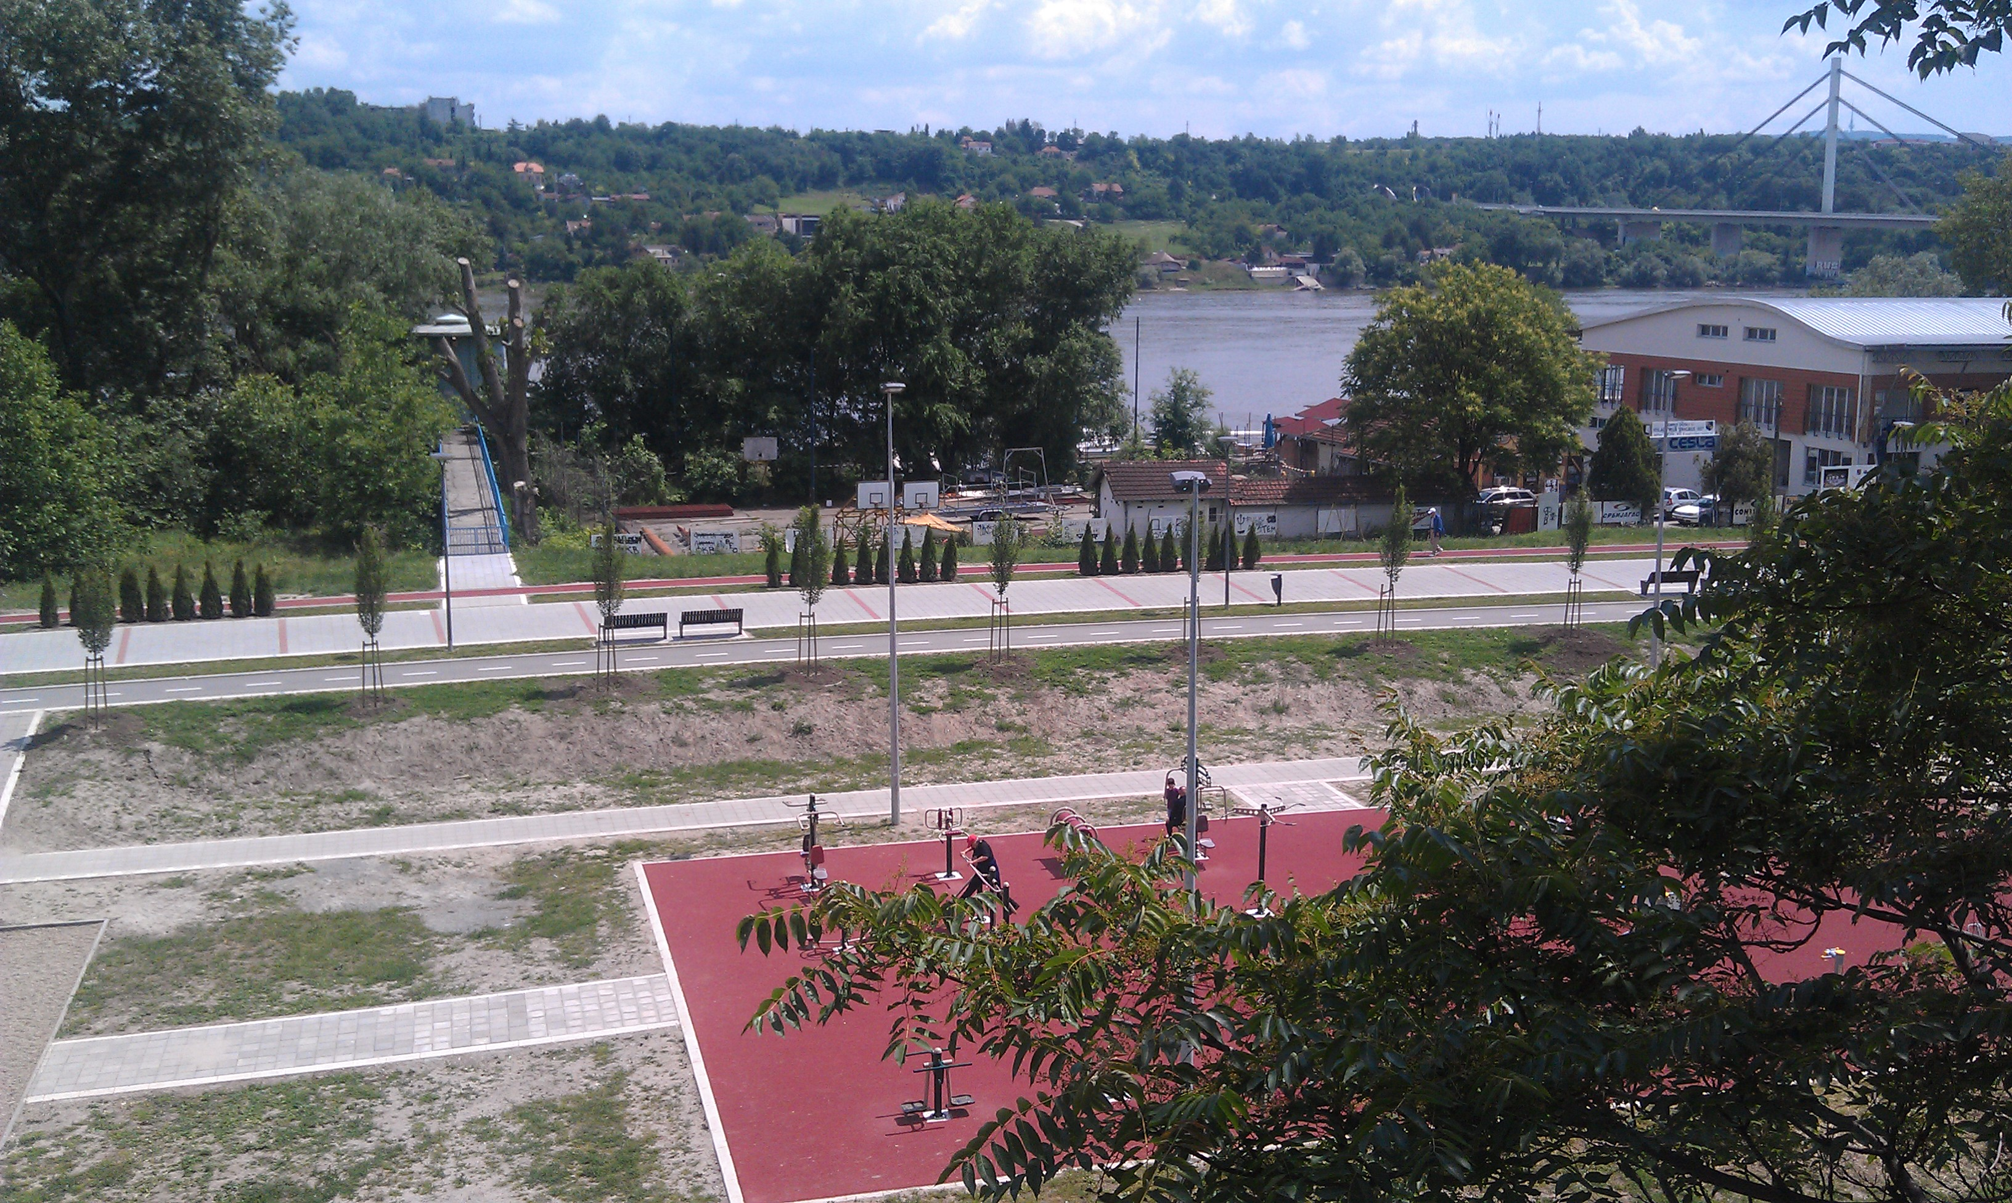
Novi Sad: Guest apartment and window view on Dunav

Slide 39
Bust of the first wife of Albert Einstein Mileva Marić-Einstein at the entrance to the UNS school of mathematics

Slide 40
Fulbright Program presentations at UNS
Fulbright Specialist Program Presentation I:
An experiential approach to elementary school mathematics
Експериментални приступ основних школа математике
Fulbright Specialist Program Presentation II:
Discovering new mathematical knowledge in the context of (secondary teacher) education
Откривање новог математичког знања у контексту (наставник средње) образовање

Slide 41
Learning to use cell phone

Slide 42
Novi Sad downtown

Slide 43
Novi Sad downtown

Slide 44
Novi Sad: The Cathedral at the Liberty Square

Slide 45
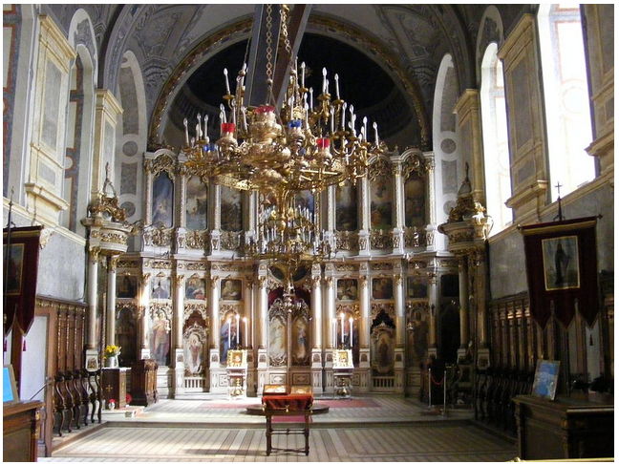
Novi Sad: Serbian is the second oldest Slavic Orthodox Church (after Bulgarian)

Slide 46
On the bank of Dunav with Prof. Crvenković

Slide 47
A street dog in Novi Sad

Slide 48
Downtown Belgrade

Slide 49
Serbia through the lens of a SUNY student
“My trip to Serbia this summer was a very invigorating experience, as I stayed for three weeks enriched in the Serbian culture- surrounding myself with European ideals and manners. As a student, it was also an experience that pushed me outside of my comfort zone, which as a young adult is very imperative. To be placed in an environment that speaks exclusively Serbian and follows a different way of life is a very unique understanding that I believe everyone needs to experience at least once in their lifetime. The universities were much different from what we have in the United States but the quality of education and excitement in the Serbian students could show you the success of their school systems. The students eagerly showed me the projects they had been working on and it was evident they were serious in pursuing the best education they could attain to receive a good job in the future. Overall, my trip to Serbia was valuable to my growth as a student and as a young adult, and I hope everyone has an opportunity to travel abroad as I did.”

Slide 50
Collaboration
Reviewing papers for conference proceedings (of international importance) published by University of Novi Sad
Memorandum of Understanding between SUNY Potsdam and University of Nis has been signed
Continuing work on the journal Open Mathematical Education Notes with colleagues from Serbian Universities
Editing a special issue of IMVI

Slide 51
MOU signed!

Slide 52
What was achieved in terms of Fulbright Specialist Program expectations?
Take part in ... conferences in conjunction with other scheduled activities: Plenary talk in Sombor at International Conference on models of integrating primary school subjects;
Consult with administrators and instructors of non-U.S. post-secondary, degree granting institutions on faculty development: MOU signed with University of Niš;
Participate in or lead seminars ... at non-U.S. post-secondary, degree granting academic institutions:
Seminars for faculty, students, practicing teachers on mathematics education; meetings with faculty to encourage and help to publish mathematics education research

Slide 53
Photos courtesy of SUNY Oswego Arts major Leonard Abramovich

Slide 54
Thank you
Next seminar: October 3rd, 2012
Dr. Sharon Williams
Fostering Mohawk Cultural Competency for Non- Native Teachers

